Slide 1
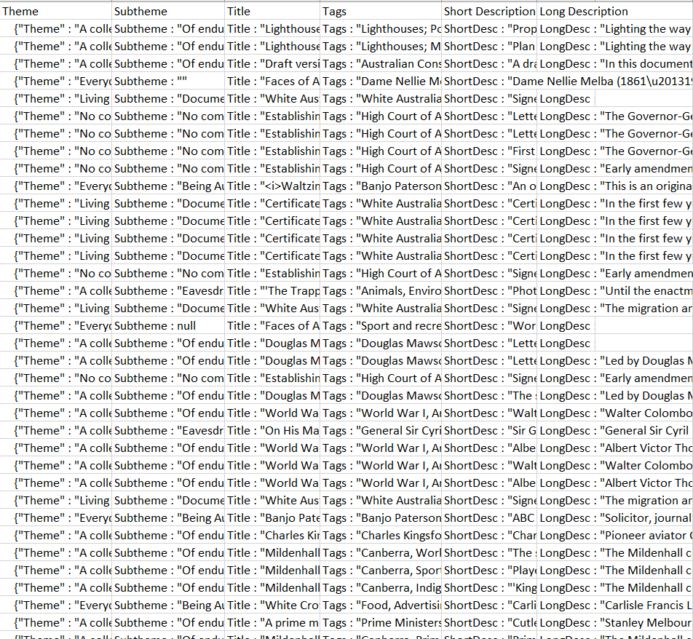
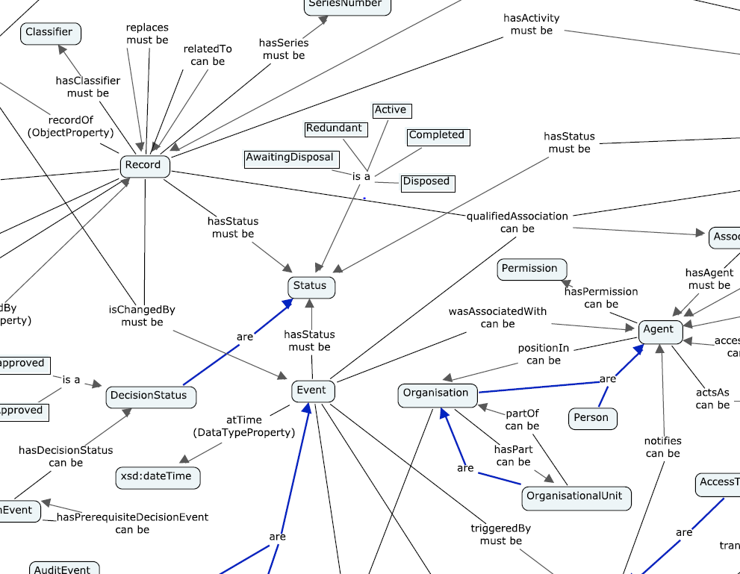
Australian Government Records Interoperability Framework
Government data is often arranged in a tabular structure. This can make it difficult to infer relationships.
Records management is dependent on content and context. ‘Context’ is synonymous with ‘relationships’.
Arranging government data in a graphical structure provides a rich picture of relationships and ‘meaning of things’ that is easily understood by people and machines.
The Australian Government Records Interoperability Framework (AGRIF) provides a standardised structure to manage records in a graphical manner. This creates a rich picture that provides an overview of relationships which is useful for understanding the functions of government.
This standardised structure emphasises the connectedness of things (like records ‘content’ and ‘context’), permitting a range of search strategies that lead to more efficient discovery, information use and records management.
By using World Wide Web Consortium recommendations, machines, including complex reasoners, can consume all types of information assets.
This ‘linked data’, or ‘semantic web’ approach can be used for activities beyond records management. Fixing disparate datasets in a graphical structure and capturing relationships creates a point for relating and aggregating data.

